Slide 1
WORKSHOP
Mindsets for Co-design in Organizational Contexts
Project Heart December 2023
Notes:
Introductions - Gillian or Sarah

Slide 2
Project Collaborators in alphabetical order
A Collaborative
Endeavour to Co-envision
Meaningful Engagement
Team of community members with lived experience, researchers, designers, and policy analysts with diverse experiences in the healthcare system.
Funded by the Solutions Fund: employee-led innovation and experimentation
Elias Abou-Rjeili
Mary Beaucage
Sarah Berglas
Alex Bray
Nancy Campana
Preet Chahaun
Olivia Chan
Kristi Coldwell
Sandra Davidson
Elyse Dorosz
Sarah Douglas
Laura Dunkley
Manuel Escoto
Nadine Hare
Anya Henry
David Hillier
Len Hodder
Linda Hunter
Lydia Lauder
Tieni Meninato
Yoshith Perera
Zal Press
Batul Presswala
Prubjoth Sidhu
Juanna Ricketts
Rup Roy
Wilson Sanon
Maureen Smith
Lanre Tunji-Ajayi
Jamie Tycholiz
Ika Washington
Linda Wilhelm
Cathy Woods
Louise Zitzelsberger
Notes:
Mary

Slide 3
We recognize that we all live and work in different places and therefore on different traditional Indigenous territories.
We have the responsibility as contemporary stewards of the land to show respect for the contributions of Indigenous peoples dating back countless generations. On a national level, we encourage all people living and visiting Canada to learn about the Indigenous people of the lands on which they live, work or visit. In the spirit of truth and reconciliation, we respect the self-determination of First Nations, Métis and Inuit, and their rights and responsibilities in cultures, languages and the pursuit of wellness.
We invite you to explore the Native Land website to learn more about the land you live and work on.
Notes:
Mary

Slide 4
“The times are urgent, let us slow down."
Bayo Akomolafe
Let's take a moment together to pause. Breathe.
Let's tap into our willingness to connect, listen,
and envision something different.
Notes:
Mary
Previous speaking notes are below - feel free to use your own.
With that, we wanted to start with pausing for you to arrive and slow down and to sit with the acknowledgements. As Philosopher Bay Akomolofe reminds us - the times are urgent, let us slow down - in other words, slowing down might be the most radical thing we can do in these pressing times
Before diving in we want to recognize that the format of a relatively short meeting is in a way in tension with some of the learnings we will speaking about - for example, we will be speaking about moving at the speed of trust (instead of pre-established outcomes) and this takes time. These are some of the inherent tensions that might come up as we explore co-design today - and our invitation to you is to let go of good or bad or right and wrong, and instead explore the implications of different ways of working - what does it allow or limit.

Slide 5
We find ourselves in a moment of cultural change — people are becoming increasingly dissatisfied with opaque and top-down processes.
They are demanding increased transparency and expecting to meaningfully shape the decisions that will impact them.
Co-Design
Introduction
Sanders and Stappers (2008); Sheard et al. (2019), Kavakil (2021).
Notes:
Mary
We find ourselves in a moment of cultural change — people are becoming increasingly dissatisfied with opaque and top-down processes. And this is happening across a broad range of areas - including policy making, corporate decision-making.
Instead, people are demanding increased transparency and expecting to meaningfully shape the decisions that will impact them.

Slide 6
“
The pandemic raised the question, have people lost trust in government? Or is the bigger problem that governments don’t trust people?
Either way, the path to re-building trust involves greater citizen participation in decision making.
Z. Press, Collaborator
Project Heart A Collaborative Exploration of the Future of Engagement 2023
Notes:
Mary
And PWLE shared this sentiment with us throughout
“The pandemic raised the question, have people lost trust in government? Or is the bigger problem that governments don’t trust people?
Either way, the path to re-building trust involves greater citizen participation in decision making.”

Slide 7
The Challenge
Engagements are no longer a nice to have: roundtables, working groups, committees and councils that include persons with lived experience are becoming more common across governments and other sectors.
Yet, when we do engage people, we often focus on what we (as engagers) need and is achievable — we have little understanding of the needs and desires of those being engaged.
Notes:
Sarah
We entered this space with a foundational challenge
Engagements are no longer a nice to have: roundtables, working groups, committees and councils that include persons with lived experience are becoming more common across governments and other sectors.
Yet, when we do engage people, we often focus on what we (as engagers) need and is achievable —we have little understanding of the needs and desires of those being engaged.

Slide 8
The Project Goal
Understanding engagement from the perspective of those being engaged (PWLE*) and how we, as government employees, can approach engagements so they are meaningful, inclusive, and impactful for all involved.
*PWLE: Person With Lived Experience:
Language matters — rather than assuming what is best, collaborate with the communities you are engaging to co-define a lexicon that aligns with their needs and desires.
Notes:
Sarah
So our goal was to
Understanding engagement from the perspective of those being engaged (PWLE*)
and how government employees can approach engagements so they are meaningful, inclusive, and impactful for all involved.
We employ the word PWLE in this presentation to speak about people with lived experience.
Someone who has direct personal experience with the specific subject matter.
Inclusive of a broader scope of descriptors such as patient, family, caregiver, citizen, and community member.
What became clear throughout the work is that language matters: the words we use define how we see people and what we see as possible
As such part of the process was to co-define as a team the lexicon we would use
PWLE overall was what resonated most with people as it honoured people's actual human experience in a respectful way

Slide 9
Our Approach
Grounded in Design Thinking and Design Research
Step 01 | Environmental scan
Step 02 | Interviews with PWLE
Step 03 | Co-design sessions with PWLE and policy-analysts
Notes:
Sarah
So how did we approach this challenge
We undertook three keys teps
Environmental Scan - review of literature on the topic, including best practices. Interviews with policy analysts and practitioners outside of HC who are doing engagement differently.
Interviews with PWLE exploring the current state of engagement and their ideal engagement experience.
We learned very quickly that engagement often felt one sided and didn’t engage people as experts in their own right.
It became clear that it was important for us to move beyond just having PWLE input into a process and actually open space for them to be co-creators, and co-designers of what an ideal engagement experience would look like. So we tested this out! We held a series of co-design sessions bringing together policy analysis and PWLE to co-envision what an ideal future of engagement would be.

Slide 10
The Tension
When people speak of ideal engagements, they often speak of: | When people speak of past engagement experiences, they often speak of:
Collaboration Partnership Trust Strong relationships | PWLE: Feeling as though they are being invited to check a box, being a token, or feeling that their engagement is inconsequential Policy analysts: Feeling as though they are stuck in a method and process that doesn’t serve them; unsure if they are getting it “right”
Notes:
Sarah
The first thing that became clear was that there was a foundational tensions between how people spoke about ideal engagements vs past engagements
When speaking about ideal engagements they spoke about collaboration, partnership, trust and strong relationships
But when they recalled their past experiences with engagement, PWLE often felt as though they had been engaged as a check box activity or their engagement was inconsequential, a tokenistic exercise
Interestingly, policy analysts also felt uneasy - they often felt as though they are stuck in a method and process that doesn’t serve them; unsure if they are getting it “right”

Slide 11
“
Project Heart
Co-design at the centre of engagement
People are not really engaged, not really respected, not usually utilized to their full potential. It's a big turn off, and it hurts people. And it actually creates trauma.
PWLE
It’s difficult to balance out where you feel there's real added value (to engaging people), to what extent you need to engage so that you make sure that you keep them safe, (and making sure its) not just tokenism.
Policy Analyst
Notes:
We had the opportunity to experiment with co-design under Project Heart
We started the project by doing a series of interviews with policy analysts and people with lived experience
What became clear is that the current state often wasn’t working for people
PWLE often felt like they were being invited to check a box or were a token. They wanted to be more than a source of data - they wanted to be brought in as partners, and have the opportunity to collaborate on creating solutions.
They wanted to collaborate on creating ideas, strategies and solutions to the topic they were being engaged on
QUOTE
Policy analysts on the other hand: felt as though they are stuck in a method and process that doesn’t serve them; unsure if they are getting it “right”
QUOTE
Faced with this dissatisfaction, we turned to co-design as a way to experiment how we might do engagement differently

Slide 12
Experts
We know better
User Experience
Empathy
Co-Design
Beyond Empathy
Community Participation
Co-Design: Shifting how we see people with lived experience
Traditional Experts / Designers
People with Lived Experience
Hare, Nadine and Jananda Lima (2022). Design's Colonial Myths: Re-envisioning the Role of the Designer in Adaptation. Cumulus.
Notes:
In this moment, practices like co-design have the potential to help us respond to this desire, need for meaningful engagement.
In co-design, “users” (the people who are the intended users of a service/product) become part of the design team
Rather than being inputs into a process, they are given the position of ‘expert of their own experience’, and play a large role in knowledge development, idea generation and concept development.
Co-design thus requires a fundamental shift in how we see and engage people
Co-design asks us to reframe our roles as experts, designers and policy analysts
This requires a shift away from the designer and/or policy analyst being the central figure or player
Instead, it requires a belief that all people are creative and are experts of their own experience
In this way - co-design is more than a set of tools, it's a different ethos, mindset - changing your mindset from expert to shared creating and envisioning

Slide 13
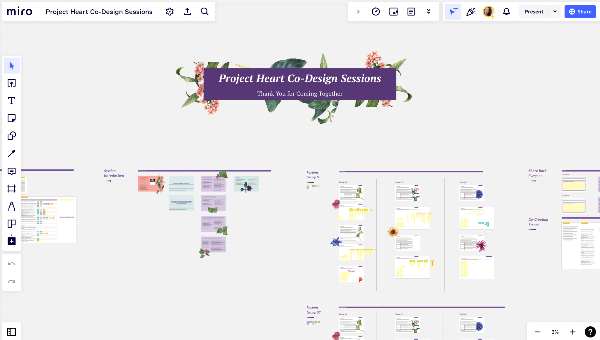
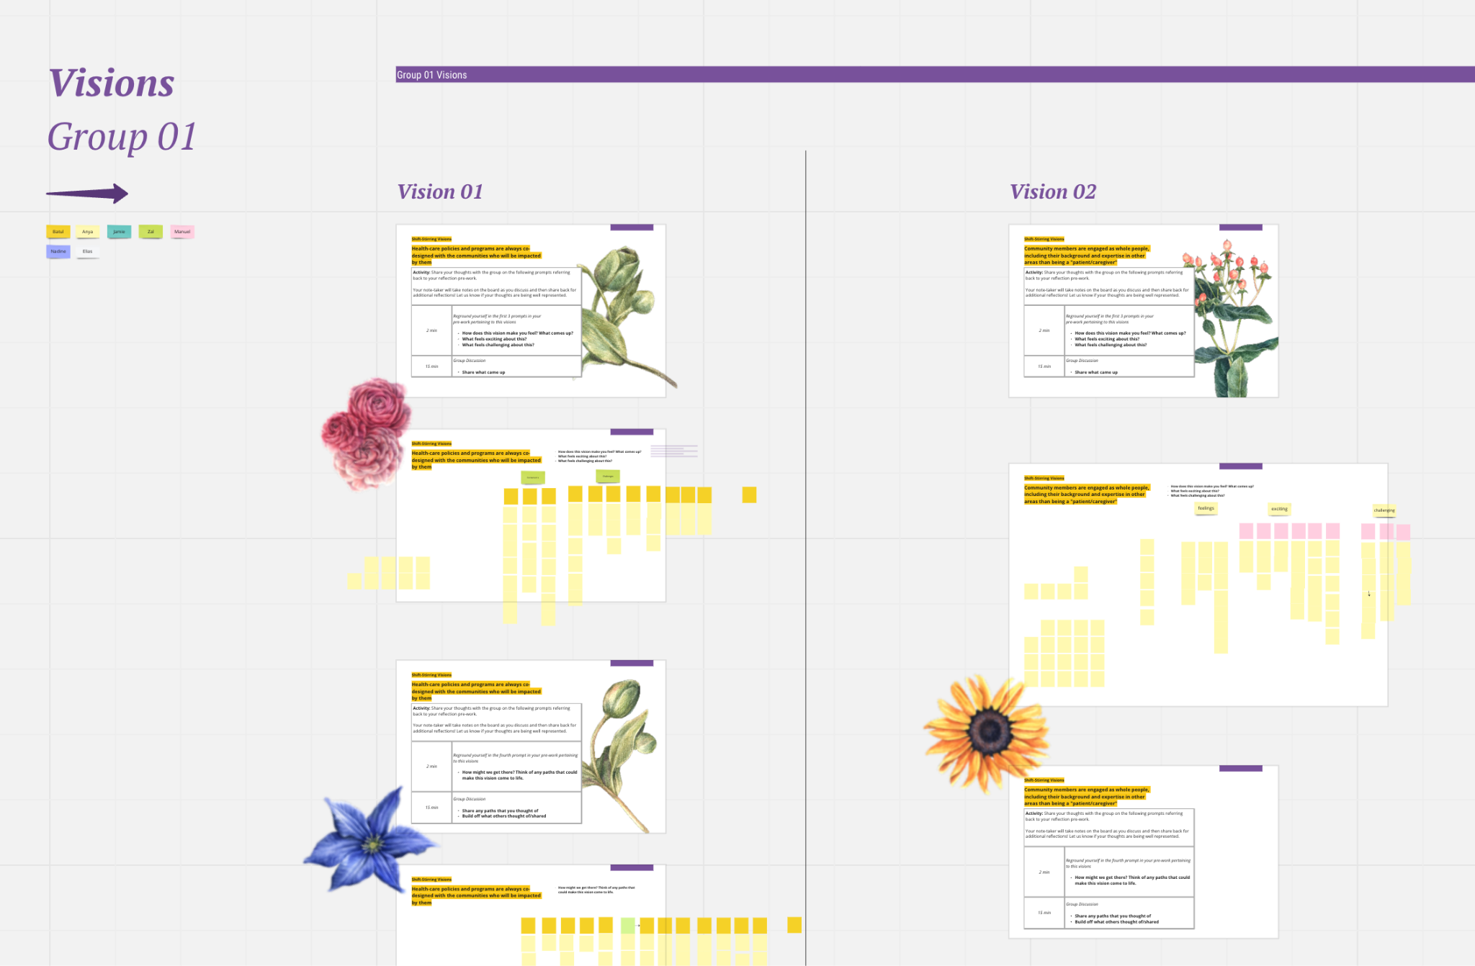
Notes:
Sarah
So how did we co-design? Where did we start?
We had a sense of what we might want to do in a co-design session and we considered moving ahead with it
BUT then we took a step back - we asked ourselves, if the goal here is to conduct research in a more participatory manner, why are we the ones deciding how the research will be conducted? How might we challenge that assumption and what does that allow? We also recognized that we didn’t want co-design to just become another check box activity, a set of things to do, or activities to move people through. We wanted to explore what embodying the ETHOS of co-design might look like
So we decided to bring together a team of policy analysts and PWLE to envision the co-design session - to co-design the co-design sessions. We spent time exploring what we wanted these sessions to do, our concerns around the sessions, who we thought should be involved, and what the impacts should be.
From there we tested the draft sessions with a different group of co-designers and gained more feedback that we brought back to the core co-design team
Through this process we heard that relationship building is key - so instead of running 3 co-design sessions with different groups, we scaled back and aligned on running 3 sessions with the same group, to give everyone more time and space to connect
We eventually aligned on a series of sessions that focused on co-envisioning what an ideal engagement experience
The sessions themselves included asynchronous individual reflections and 3 online meetings time where co-designers envisioned in small groups comprised of policy analysts and PWLE
This involved reviewing a list of desired visions for the future of engagement and prioritizing which felt most important or impactful - for example, people prioritized the idea that in the future “Health-care policies and programs are always co-designed with the communities who will be impacted by them”
And then exploring excitement and challenges that might emerge from these visions
From here they ideated possible paths or solutions that could get us there the sessions built off the people’s stated desires for engagement in the original interviews that
The last sessions was focused solely on gaining feedback on the experience, learning how we might improve the co-design experience in the future
We did all of this using Miro - doing so so pivotal as it allowed us to build a space in which everyone could contribute at any time, and ensured transparency in decision - making

Slide 14
Co-Design: Commitment to learning and adapting
Notes:
Sarah
What we observed throughout the process is that this is not an all or nothing thing
Throughout the entire process we aimed to be in co-design, but were faced with vacillations - because of time, because of structures, because of our assumptions
We learned that earlier in the process the messier things are - and that can be the hardest part to include people - we haven’t built strong relationships yet, and we are asking people to jump into the mess with us - and yet at the same time the earlier in the process the more effective it is
This required a commitment to learning and adapting - and understanding that we won’t get it right right away
This also challenged us to ask what is our metric of success - is it getting good solutions? Or is it facilitating an experience that leaves people feeling dignified and well along the way?

Slide 15
Co-design tensions
Co-design is a complex, contradictory, sometimes antagonistic process, in which different stakeholders (design experts included) bring their specific skills and their culture. It is a social conversation in which everybody is allowed to bring ideas and take action, even though these ideas and actions could, at times, generate problems and tensions.
Manzini, Enzo (2016). Design Culture and Dialogic Design. Design Issues
Project Heart A Collaborative Exploration of the Future of Engagement 2023
Notes:
Sarah
What this reminds us is that this process is complex and at times contradictory as designer Manzini reminds us
Co-design is often a process that is different to what we are used to or to the way orgs are structured - and this surfaces tensions and problems arise
In this manner, it can require time and investment to work with each other differently - we recognize its a very different way than how we are structured and our orgs and structured
(Tension example if emerges)
One of the tensions that came up for example is around desiring clarity on impacts - part of what was the challenge is that the impacts were unclear because of the exploratory nature - but people rightly so wanted to clarity on what the impacts might be before agreeing to participate

Slide 16
The Main Learnings
Preferred Approaches for Meaningful Engagement
Relate as collaborators
PWLE are collaborators in the entire engagement process, and co-envision the engagement itself.
Foster inclusive spaces
Engagements address and recognize power dynamics and privilege to help create more inclusive and caring spaces.
Value whole people and their perspectives
PWLE are seen and valued as an expert in their own right, and are engaged as whole people.
Demonstrate deep listening and show impact
Contributions from PWLE are heard and included in engagement outputs, and the potential impact of these outputs are clear from the start.
*A complete list of recommendations for each approach is included in the final report.
Notes:
Sarah
We learned about principles that can bring about more caring engagements
Relate as collaborators: PWLE are collaborators in the entire engagement process, and co-envision the engagement itself.
Foster inclusive spaces: Engagements address and recognize power dynamics and privilege to help create more inclusive and caring spaces.
Value whole people and their perspectives: PWLE are seen and valued as an expert in their own right, and are engaged as whole people.
Demonstrate deep listening and show impact: Contributions from PWLE are heard and included in engagement outputs, and the potential impact of these outputs are clear from the start.
What was interesting about this is we struggled to create these - we worried that they would be used as a checklist, and in doing so recreating the very problem we were trying to avoid - we worried people would skip all the rest and just look for a list of things to do - although we understood this desire (we had wanted to do the same things at times), we had also learned that this was part of the challenge
Although guidelines are pivotal to creating change, on their own, they can at times reinscribe the very problems we are hoping to solve.
We were reminded of this repeatedly throughout the project. For example, during one of the co-design sessions, the aim was to ideate guidelines around what “good”communication looks like during the entire engagement process. Many of the co-designers kept on reminding us that “good” communication wouldn’t come from simply telling engagers to ensure that they do a set of actions (e.g., send an email to explain the goals of the session). Although this was important, on their own, these prescribed actions could easily start to feel like a box-checking exercise and leave Pwle feeling tokenized once again.

Slide 17
The Learnings
The Learnings
The Main Learnings
Strong relationships are the roots of meaningful engagements
More meaningful engagements are:
Less about following a predetermined checklist or about the tools, tech, and methods used
More about building strong relationships that lead to true collaboration
Notes:
Sarah
What became clear is that
Strong relationships are the roots of meaningful engagements
In other words, meaningful engagements are:
Less about following a predetermined checklist or about the tools, tech, and methods used
More about building strong relationships that lead to true collaboration

Slide 18
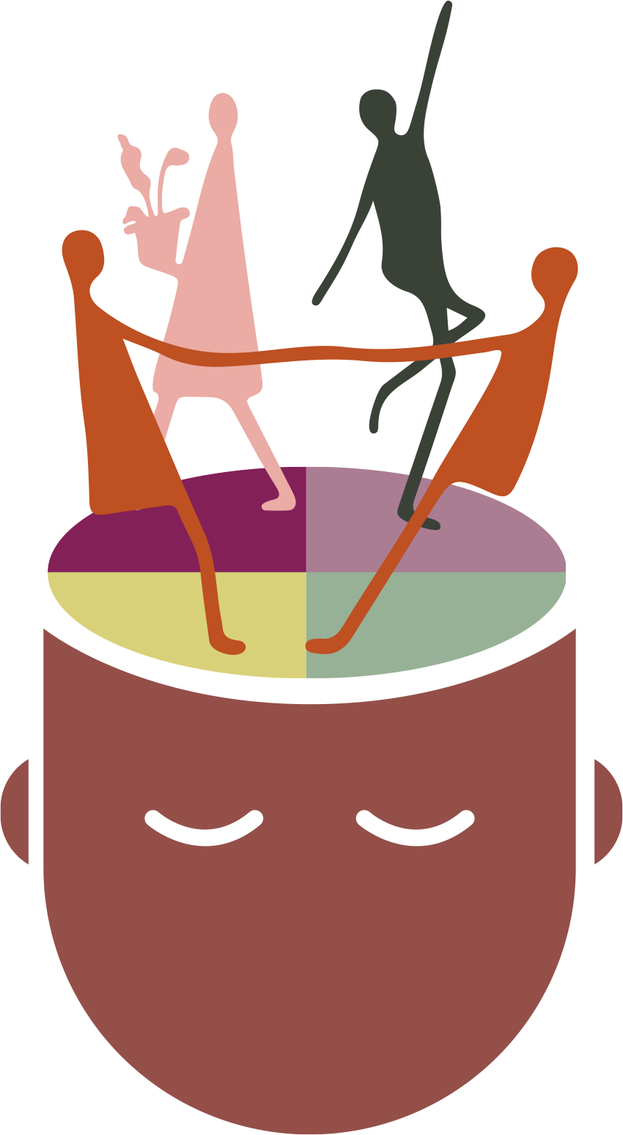
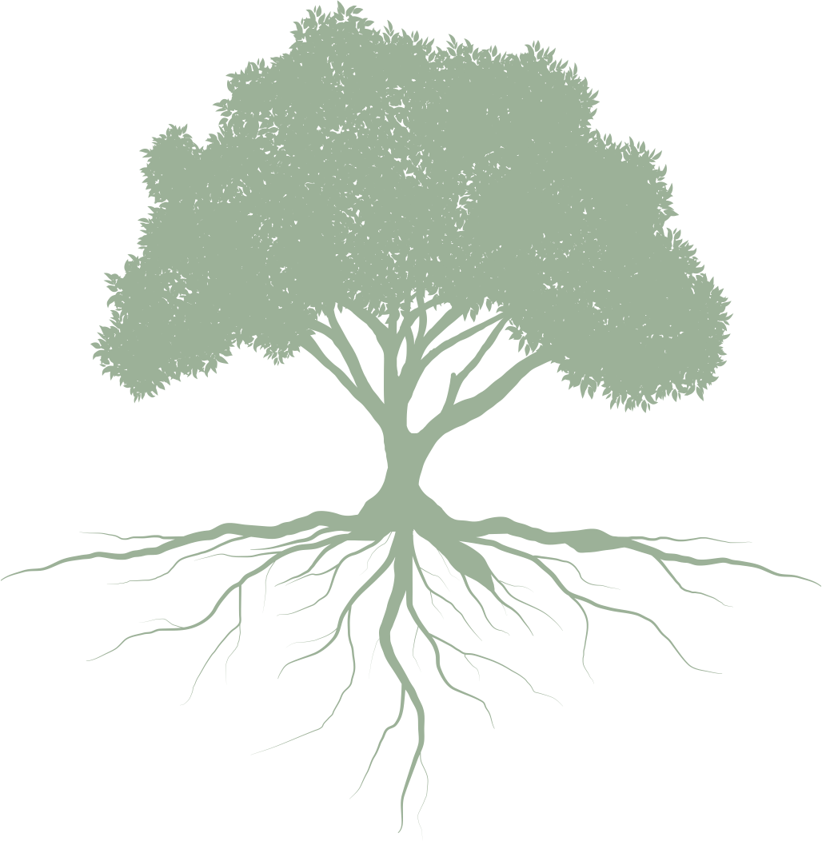
The Main Learnings
The Main Learnings
Preferred Approaches
Changing how we do engagement
Mindset Shifts
Changing how we think about engagement
Engagements that are more meaningful and impactful for all
Notes:
Sarah
Ultimately throughout all of this we learned that to design engagements that are more meaningful and impactful we needed to
Shift the way we are doing engagement - shift our approach
Shift the way we are thinking about engagement - shift our mindset
In other words, these approaches wouldn’t be transformational unless we had taken the time to critically reflect on the mindsets that are driving our actions
So we developed a set of mindsets that alongside the principles can bring about more meaningful engagements

Slide 19
“
I've done hundreds of surveys but actually stopped doing them because often I don't get feedback on those surveys. [They will] send you your honoraria, but [I] rarely ever hear what kind of impact my input may have had.
PWLE
About 65-75% of the work is building relationships and 25% of the work is actually doing the work that you are setting out to do.
PWLE
Project Heart A Collaborative Exploration of the Future of Engagement 2023
Notes:
Sarah - PAUSE HERE FOR QUESTIONS
First quote represents that experience of being an input
Second quote the labour that is required as we move to focusing on needs of participants.

Slide 20
The Main Learnings
To be in a space for change:
Try letting go of “right/good” or “wrong/bad.” Reflect on the limits of actions, rather than blaming people.
Try reflecting more on if/how our mindsets are serving a purpose.
Mindset Shifts
Definition Habits of thought — deeply held beliefs and assumptions and taken for granted ways of operating that influence how we think, what we do, and how we talk (Kania et al.).
Established the common way, what has been often done | Emerging the less travelled path, what has often been forgotten
Notes:
Nadine
Before diving into the mindsets I want to clarify what we mean by establish and emerging
When we speak of established vs emerging - this is NOT about saying that established is wrong or bad and emerging is good
We do not mean to say that current Established Mindsets are wrong or bad - these models have greatly served us (and continue to serve us). However, opening space for models that have been on the margins, allows us to meet needs that have often been underserved and challenge how we usually think about what success looks
PAUSE - any questions, concerns, discomforts
When we share this people often struggle with feasibility. Keep in mind your habits of thought that can make it hard for us to see the possibility for change
Example of time
Example of interpersonal change vs waiting for top down
I will walk you through each mindset shift and after each one you will reflect on the challenges and what excitements might come up
Get your paper and pen ready

Slide 21
REFLECT:
Established Mindset the common way, what has been often done | Emerging Mindset the less travelled path, what has often been forgotten
Expert Driven Traditional experts are the best poised to make decisions. Experts know more than non-experts. | Collaborative Decision-making is most effective when it happens between diverse experts and the people who will be impacted by the decision. PWLE have valuable “expertise” that cannot be accessed solely through academic training.
What feels exciting?
What feels like a challenge?
Notes:
Nadine
Expert Driven: Traditional experts are the best poised to make decisions. Experts know more than non-experts.
Collaborative: Decision-making is most effective when it happens between diverse experts and the people who will be impacted by the decision. PWLE have valuable “expertise” that cannot be accessed solely through academic training.
Take a few moments to reflect on this mindset, specifically
What feels exciting about it
What feels like a challenge

Slide 22
REFLECT:
Established Mindset the common way, what has been often done | Emerging Mindsets the less travelled path, what has often been forgotten
Goal Oriented Success is based on our ability to accomplish project goals and emerge with rigorous data. Move at the speed of the predefined timeline. | Process Oriented Success is based on the quality of the experience of going through a project. Move at the speed of trust. ⁰¹
What feels exciting?
What feels like a challenge?
01 Brown, Adrienne (2021)
Notes:
Nadine
Goal Oriented: Success is based on our ability to accomplish project goals and emerge with rigorous data. Move at the speed of the predefined timeline.
Process Oriented: Success is based on the quality of the experience of going through a project. Move at the speed of trust.
Take a few moments to reflect on this mindset, specifically
What feels exciting about it
What feels like a challenge

Slide 23
REFLECT:
Established Mindset the common way, what has been often done | Emerging Mindsets the less travelled path, what has often been forgotten
Keeping things under control Knowing the right path from the jump, and avoiding failure when possible, makes for a successful project. Making mistakes is a setback and risks undermining our credibility. | Embracing learning and openness Being open to what emerges and being able to hold multiple viewpoints makes for a successful project. “Failure” is learning; it allows people to be perceived as complex humans and invites others to provide feedback and learn alongside them.
What feels exciting?
What feels like a challenge?
Notes:
Nadine
Keeping things under control: Knowing the right path from the jump, and avoiding failure when possible, makes for a successful project. Making mistakes is a setback and risks undermining our credibility.
Embracing learning and openness: Being open to what emerges and being able to hold multiple viewpoints makes for a successful project. “Failure” is learning; it allows people to be perceived as complex humans and invites others to provide feedback and learn alongside them.
Take a few moments to reflect on this mindset, specifically
What feels exciting about it
What feels like a challenge

Slide 24
REFLECT:
Established Mindset the common way, what has been often done | Emerging Mindsets the less travelled path, what has often been forgotten
Big Data Quantitative data is the best way to understand a social experience as it is easily comparable and representative of an entire population. Outliers in quantitative data are to be excluded to avoid skewing data sets. Qualitative data is largely anecdotal, biased, costly, and time-consuming. | Deep Data Qualitative and quantitative data serve different purposes, and each offers valuable insight. Qualitative research is best suited to capturing complex and multilayered social experiences and understanding how people make sense of these experiences. Qualitative research is pivotal to innovation as it opens space for the emergence of unexpected/ divergent views that may have previously been overlooked.
What feels exciting?
What feels like a challenge?
Notes:
Nadine
Big Data: Quantitative data is the best way to understand a social experience as it is easily comparable and representative of an entire population. Outliers in quantitative data are to be excluded to avoid skewing data sets. Qualitative data is largely anecdotal, biased, costly, and time-consuming.
Deep Data: Qualitative and quantitative data serve different purposes, and each offers valuable (but different) insight. Effective research knows how to leverage the differentiated strengths of each method. Qualitative research is best suited to capturing complex and multilayered social experiences and understanding how people make sense of these experiences. Qualitative research is pivotal to innovation as it opens space for the emergence of unexpected/ divergent views that may have previously been overlooked.
Take a few moments to reflect on this mindset, specifically
What feels exciting about it
What feels like a challenge

Slide 25
GROUP ACTIVITY
Applying the mindsets
As a group, work through your chosen mindset:
Share what feels exciting and what feels challenging
Discuss: how you might implement this mindset in you work
One person per group can volunteer as a notetaker.
Project Heart A Collaborative Exploration of the Future of Engagement 2023
Notes:
Nadine
So now its time to explore these in groups -
Encourage people to start with a round of brief introductions
Explain ideation prompts
We will come back together in aprox 20-25 minutes and share back with the larger group - so think about what you would like to share back

Slide 26
LARGE GROUP ACTIVITY
Share back with the larger group
Share with the larger group your main learnings:
What was most interesting/exciting?
Did anything feel difficult and/or uncomfortable?
What questions were left unanswered ?
Project Heart A Collaborative Exploration of the Future of Engagement 2023
Notes:
Nadine
Ask per mindset!

Slide 27
“Engaging persons with lived experience is critical to improving public policy, research, and knowledge dissemination efforts.
Meaningful engagement is challenging and takes time, but Project Heart has outlined a pathway for achieving meaningful engagement drawn from current best practices and supported by the many PWLE project participants.
I challenge readers to read the report recommendations, reflect, and plan on how their spaces could allow for engagement – the opportunity is there; all that is left is your commitment to incorporate these principles and recommendations into your work.”
M. Escoto PWLE
Notes:
Sarah with Manuel’s Recording

Slide 28
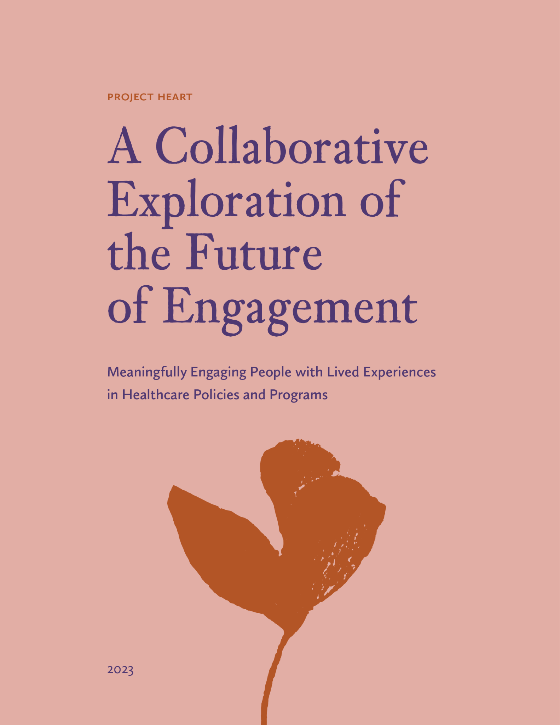
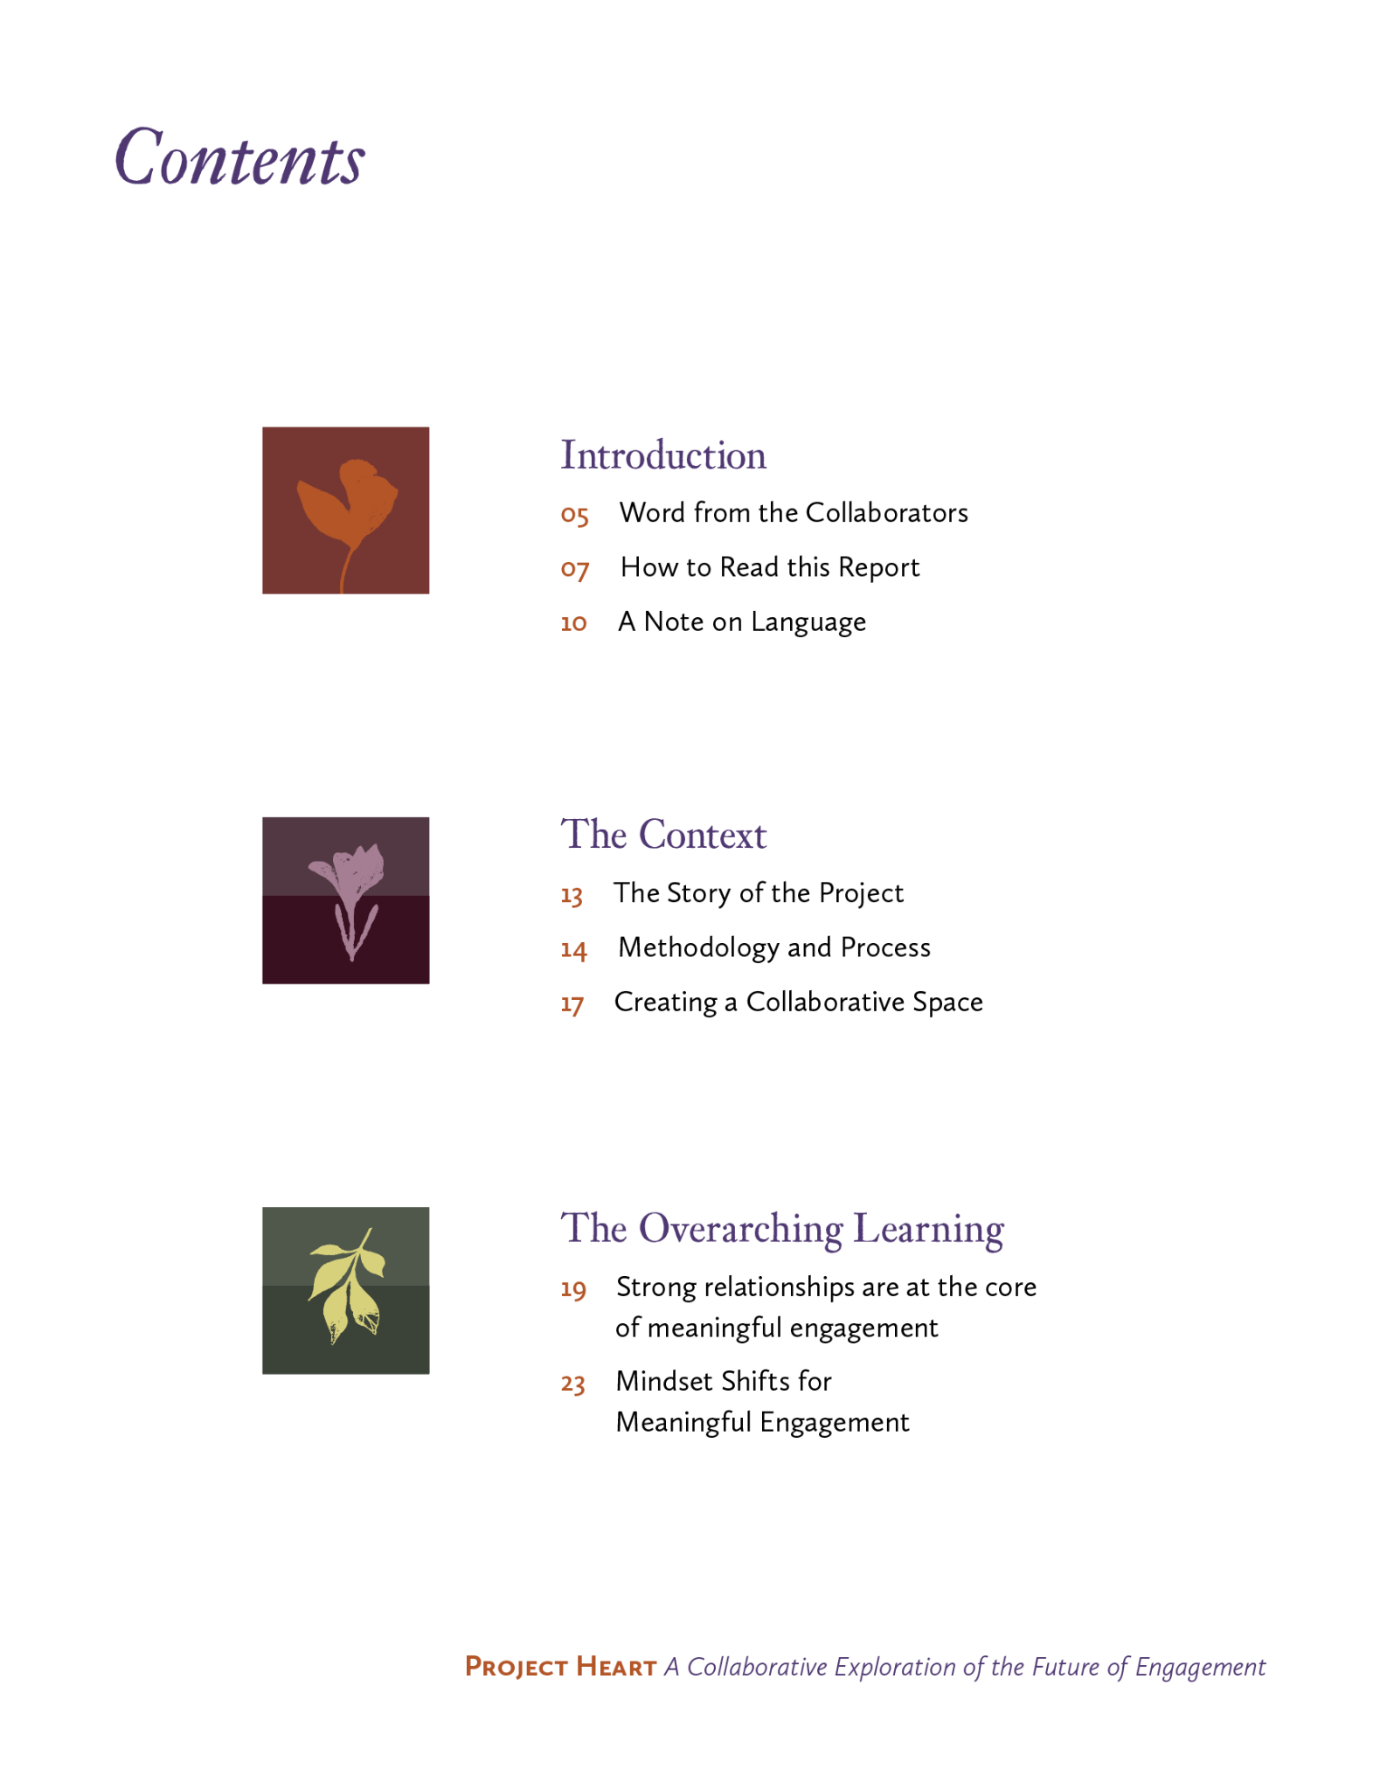
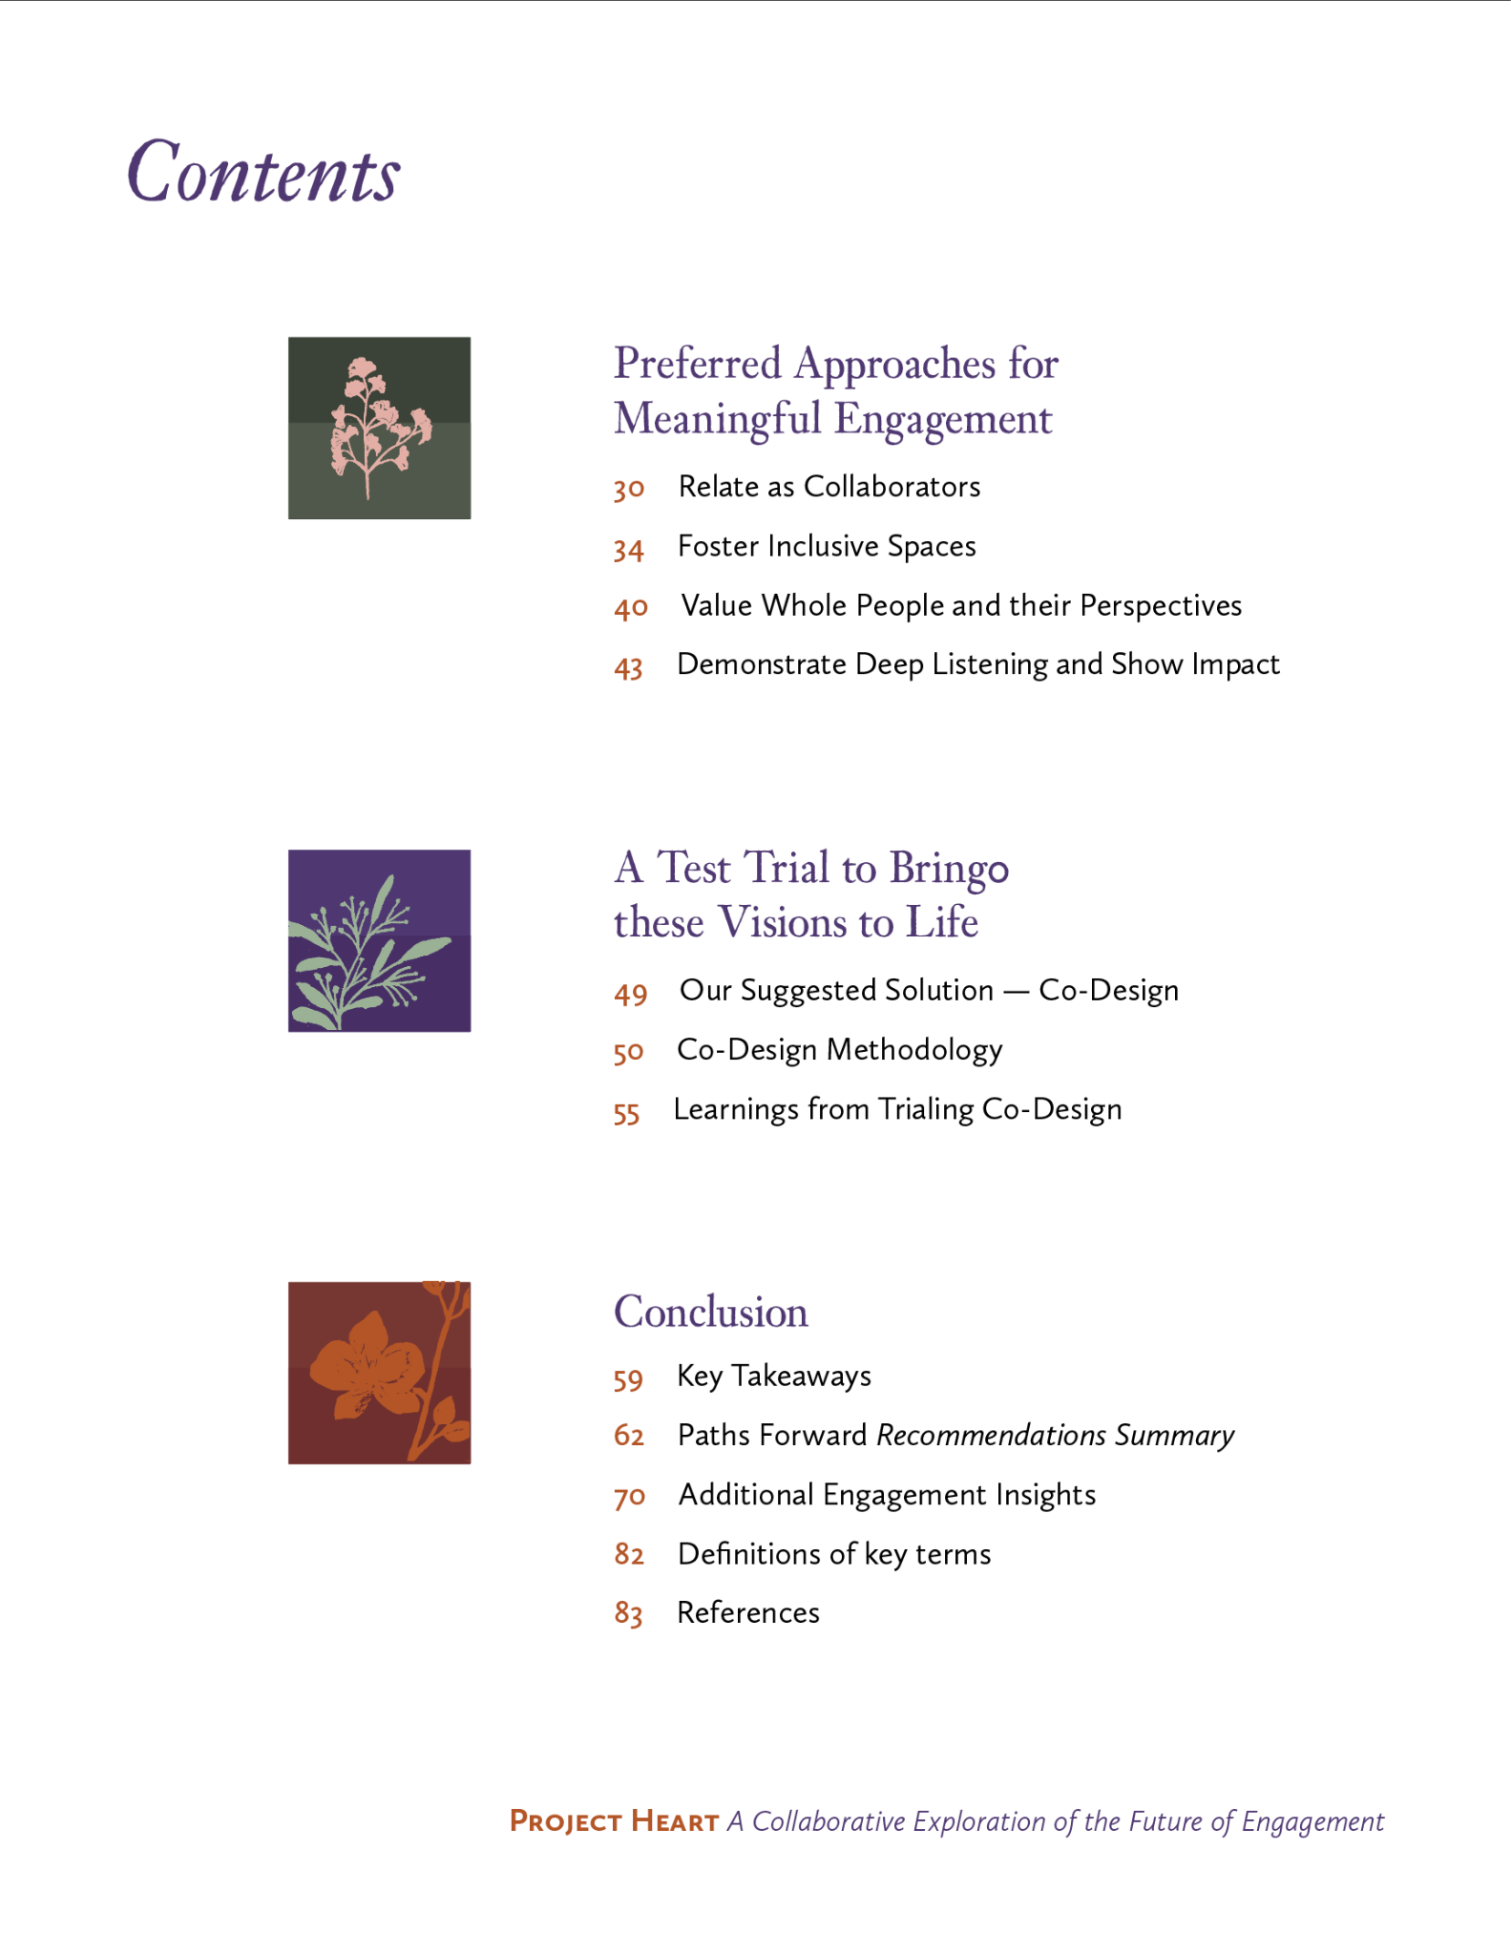
Reach out
to Read the
Full Report
A preview
Notes:
Sarah

Slide 29
Thank You
Notes:
Sarah

